Slide 1

Project Second Review on
POWER SYSTEM FAULT DIAGNOSIS USING MACHINE LEARNING
by
under the guidance of
Dr . S. Hemachandra M.Tech., Ph.D.
Professor
DEPARTMENT OF ELECTRICAL AND ELECTRONICS ENGINEERING
SREE VIDYANIKETHAN ENGINEERING COLLEGE
(AUTONOMOUS)
A.RANGAMPET, TIRUPATI – 517 102
(2016 - 2020)
EDAGOTTI PAVANKUMAR | 16121A0253
AVILALA DEDEEPYA | 16121A0208
GAYAKAWADA CHANDRASEKHAR | 16121A0265
AVULA PRAVALIKA | 16121A0209

Slide 2
Contents :
Objective
Introduction
Components Information
Simulation Results
Road Map
Applications
Conclusion
References
CO – PO Mapping

Slide 3
Objective
Power system fault diagnosis is the process of analyzing historical fault data for the detection and the classification of the current faults.
The objective of our project is detection and the classification of the faults with the help of the artificial neural networks by using past data to train the neural network.

Slide 4
Introduction
From past few decades we are very much depending on the electric power.
Transmission lines are the bridges between generating station to distribution station.
Transmission lines will undergo many types of faults as they are exposed to the open air.
The fault detection and the classification in the transmission line is very much important.

Slide 5
(Cont..)
In recent days lot of data is generating due to SCADA.
By using the deep neural networks we can classify the type of fault which is occurred in the transmission line.
But for that we need past data.

Slide 6



Components
Here we using MATLAB for the generation of the faults data for the deep neural network.
We are using Microsoft Excel with NeuroSolutions software for the training and the testing of the network.
We are using Recurrent Neural Network for the classification of the shunt faults in the transmission line.
Fig . 1 . Matlab
Fig. 2 . NeuroSolutions
Fig. 3. Microsoft Excel

Slide 7
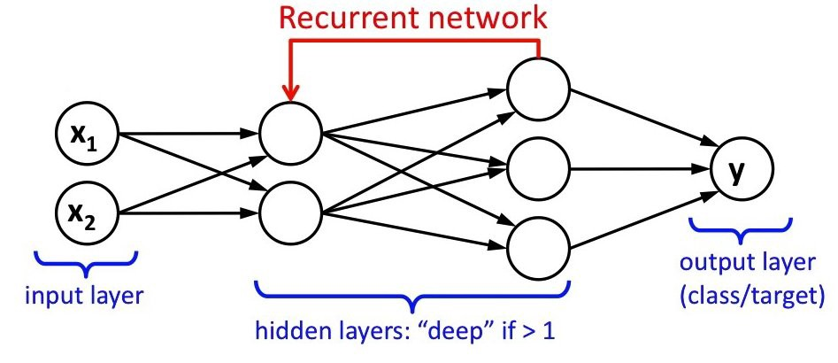
Fig. 3. Recurrent Neural Network

Slide 8
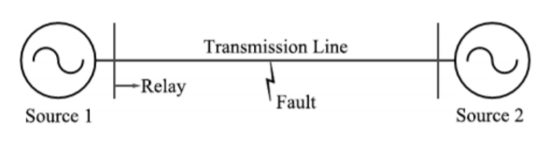
Line Voltage VL-L = 220 kV
Line Length = 200 km
Frequency f = 50 Hz
Z1 = 4.76 + j*59.75 ohms
Z0 = 77.70 + j*204.26 ohms
Fault Types : a-g, b-g, c-g, ab, bc, ac, ab-g, bc-g, ac-g, abc,
no fault
Fault Resistance : 0.001, 5 ,10, 15,20 ohms
Fault Location : 0,50,100,150,200 kms
Fig. 4. Transmission network considered for the simulations

Slide 9
Simulation Results
Best Networks | Training | Cross Validation
Epoch # | 1000 | 1000
Minimum MSE | 0.001670653 | 0.001660362
Final MSE | 0.001670653 | 0.001660362
Table. 1. Training Results
Fig. 5. MSE vs Epoch for Training

Slide 10
Performance | Fault(BCG) | Fault(BG) | Fault(BC) | Fault(AB) | Fault( AG) | Fault(CAG) | Fault(CG) | Fault(ABG) | Fault(CA) | Fault(ABC) | No Fault
MSE | 0.001041384 | 0.001228503 | 0.001267962 | 0.000949011 | 0.00103155 | 0.000609621 | 0.000751261 | 0.001670856 | 0.001259615 | 0.000699633 | 0.000936641
NMSE | 0.012227989 | 0.014361976 | 0.013714801 | 0.011078389 | 0.011540652 | 0.007375399 | 0.008873446 | 0.018414151 | 0.014619167 | 0.008108269 | 0.025133817
MAE | 0.023881474 | 0.030720223 | 0.026290921 | 0.024074968 | 0.02712062 | 0.019775526 | 0.022480201 | 0.033857771 | 0.027864911 | 0.020467848 | 0.024376238
Min Abs Error | 3.10014E-05 | 3.7502E-06 | 4.12587E-07 | 6.64737E-07 | 1.8618E-05 | 4.956E-06 | 6.39238E-06 | 9.19265E-05 | 1.13233E-05 | 5.68566E-06 | 7.6094E-06
Max Abs Error | 0.222116585 | 0.083063903 | 0.222004191 | 0.174415037 | 0.080086244 | 0.194371308 | 0.081007194 | 0.178581559 | 0.273691945 | 0.128971428 | 0.104476299
r | 0.996169263 | 0.993366015 | 0.994160264 | 0.994680123 | 0.994845309 | 0.996420527 | 0.997417854 | 0.993264984 | 0.996228945 | 0.997105661 | 0.988280479
Table. 2. Classification Results

Slide 11
Road Map
MATLAB

Slide 12
Applications
The faults in the power system will play a major role in the system stability
Fault classification is important for the operation of the healthy phases.
Power system reliability gets improved.

Slide 13
Conclusion
This project is to develop a deep neural network so that the power system faults can be diagnosed. We will try to classify them as much faults as possible using deep neural networks and further improvements in the project will be informed.

Slide 14
References
[1] | Y. Wang, M. Liu and Z. Bao, "Deep learning neural network for power system fault diagnosis," 2016 35th Chinese Control Conference (CCC), Chengdu, 2016, pp. 6678-6683.
[2] | Michau, Gabriel & Palmé, Thomas & Fink, Olga. (2017). Deep Feature Learning Network for Fault Detection and Isolation.
[3] | Florian Rudin, Guo-Jie Li and Keyou Wang, “An Algorithm for Power System Fault Analysis based on Convolutional Deep Learning Neural Networks”, International Journal of All Research Education and Scientific Methods (IJARESM), Volume 5, Issue 9, September- 2017.
[4] | B. Bhattacharya and A. Sinha, "Intelligent Fault Analysis in Electrical Power Grids," 2017 IEEE 29th International Conference on Tools with Artificial Intelligence (ICTAI), Boston, MA, 2017, pp. 985-990.
[5] | H. A. Tokel, R. A. Halaseh, G. Alirezaei and R. Mathar, "A new approach for machine learning-based fault detection and classification in power systems," 2018 IEEE Power & Energy Society Innovative Smart Grid Technologies Conference (ISGT), Washington, DC, 2018, pp. 1-5.
[6] | G. Cardoso, J. G. Rolim and H. H. Zurn, "Application of neural-network modules to electric power system fault section estimation," in IEEE Transactions on Power Delivery, vol. 19, no. 3, pp. 1034-1041, July 2004.
[7] | Jamil, M., Sharma, S.K. & Singh, R. SpringerPlus (2015) 4: 334. https://doi.org/10.1186/s40064-015-1080-x.

Slide 15
CO – PO Mapping
This project is to develop a deep neural network so that the power system faults can be diagnosed. We will try to classify them as much faults as possible using deep neural networks and further improvements in the project will be informed.

Slide 16


